Slide 1


Basic Details of the Team and Problem Statement
PS Code: PS06(02)
Problem Statement Title: Mobile App or Web Tool to Empower Farmers with Data-driven Fertilizer Recommendations
Team Name: HACKuna MATATA
Team Leader Name: SHREYANSH SAKARWAL
Institute Code (AISHE): 126
Institute Name: Heritage Institute of Technology
Theme Name: AGRICULTURE

Slide 2
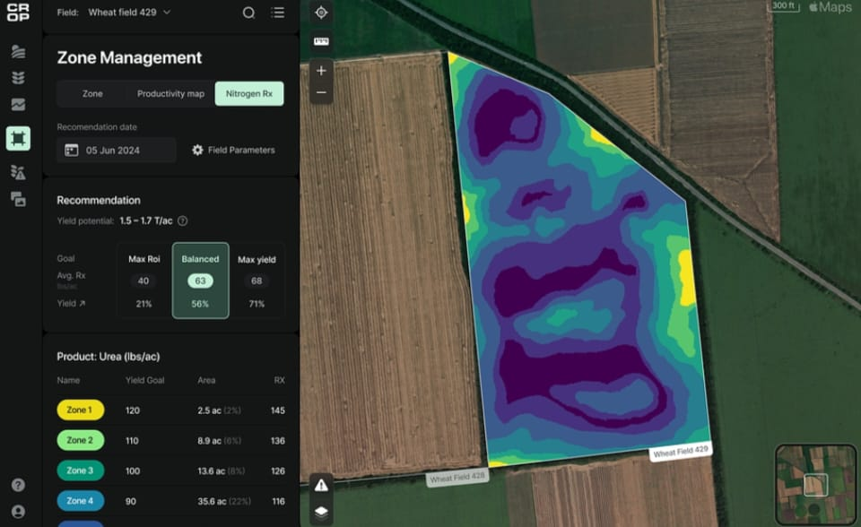
Idea/Approach Details
Describe your idea/Solution/Prototype here:
CROPIFY: Transform Your Farming with Smarter Fertilizer Use
- Personalized Recommendations: Get custom fertilizer advice tailored to your crop type, soil quality, and real-time weather data.
- Easy Data Input: Quickly enter crop details and soil data to receive expert guidance on the best fertilizer type, dosage, and application timing.
- Weather Integration: Cropify adjusts recommendations based on current weather conditions, helping you make the best decisions for your farm.
- Educational Resources: Learn about the benefits of proper fertilizer use, soil health, and sustainable farming practices.
- Tracking & Monitoring: Keep track of your fertilizer usage and see its impact on crop yields.
- Cost Analysis: Discover the economic benefits of optimized fertilizer use, saving money and increasing profits.
CROPIFY makes sustainable farming easy and profitable. Upgrade your farming practices with smart, eco-friendly solutions!
Describe your Technology stack here:
HTML-CSS-BOOTSTRAP-jQUERY
JAVASCRIPT
REACT.JS
MYSQL
REST APIs
DJANGO
FIREBASE AUTHENTICATION
PYTHON(NUMPY,PANDAS)
SCIKIT
AWS
Gr

Slide 3
Idea/Approach Details
Describe your Dependencies / Show stopper here
Describe your Use Cases here
1. Boosting Crop Yield: A farmer uses Cropify to input information about their crops and soil, receiving a tailored fertilizer plan that increases yield and cuts costs.
2. Weather-Responsive Farming: Cropify alerts a user to adjust fertilizer application based on upcoming weather, optimizing effectiveness and reducing waste.
3. Promoting Soil Health: The app provides tips on sustainable fertilizer use, helping improve soil quality and ensuring long-term farm productivity.
4. Saving Money: A small farmer discovers how to save money using the cost analysis feature, which helps avoid buying and using too much fertilizer.
5. Informed Decision-Making: Cropify enables a farmer to track fertilizer use and crop yields, providing data to make smarter farming decisions.
Dependencies:
- Accurate Soil Data: Essential for precise recommendations; relies on third-party testing or manual input.
- Weather Data: Requires reliable, real-time data for adjusting plans.
- User Input: Accurate farmer data is crucial for optimal recommendations.
- Technology Infrastructure: Stable internet is necessary, especially in rural areas.
- Data Security: Ensuring user data protection is vital.
Showstopper:
CROPIFY: Making Smart Farming Decisions
In our CROPIFY project, we use a special type of computer system called a neural network(least square regression algorithm model). This system helps us predict the best outcomes for your crops by looking at important factors like soil pH levels, nutrient content, how stressed your plants are, and how your fields are managed.
The neural network works by comparing different factors to find patterns, similar to how we learn from experience. We then adjust the system to make sure it gives predictions that are correct about 80-90% of the time. This way, you get reliable advice on how to manage your crops better, no matter the conditions on your farm.

Slide 4
Team Member Details
Team Leader Name: SHREYANSH SAKARWAL
Branch : BTECH Stream : CSE-DS Year:||
Team Member 1 Name: SHUBHAM SAURABH
Branch: BTECH Stream: CSE-DS Year:||
Team Member 2 Name: PARIJAT CHATTERJEE
Branch : BTECH Stream : CSE-DS Year:||
Team Member 3 Name: ROSHAN KHAN
Branch: BTECH Stream : CSE-DS Year:||
Team Member 4 Name: ANURAG BHARDWAJ
Branch : BTECH Stream : CSE-AI/ML Year:||

